Slide 1
Voronoi diagram

Slide 2
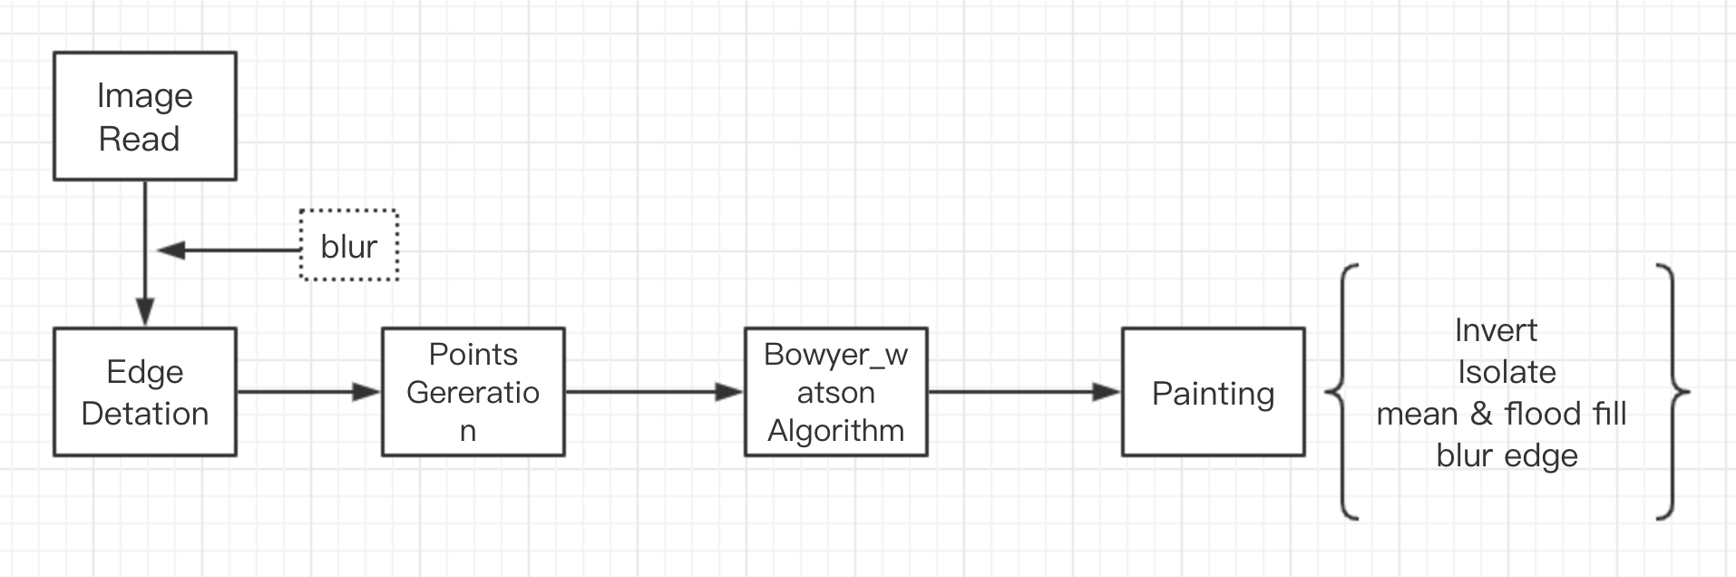
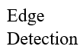
Flow chart

Slide 3
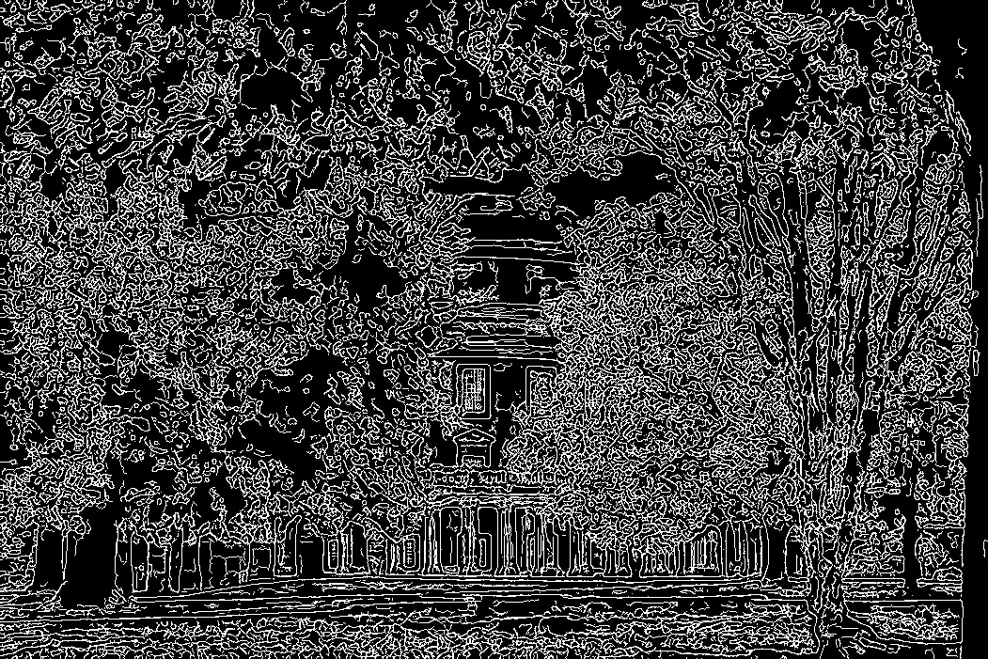
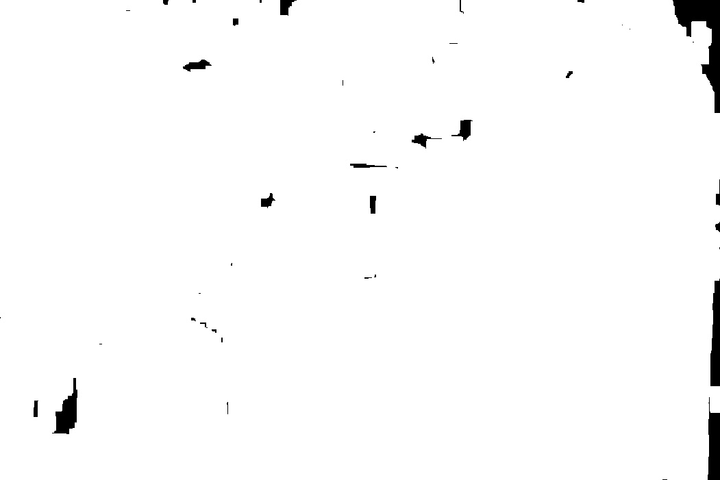
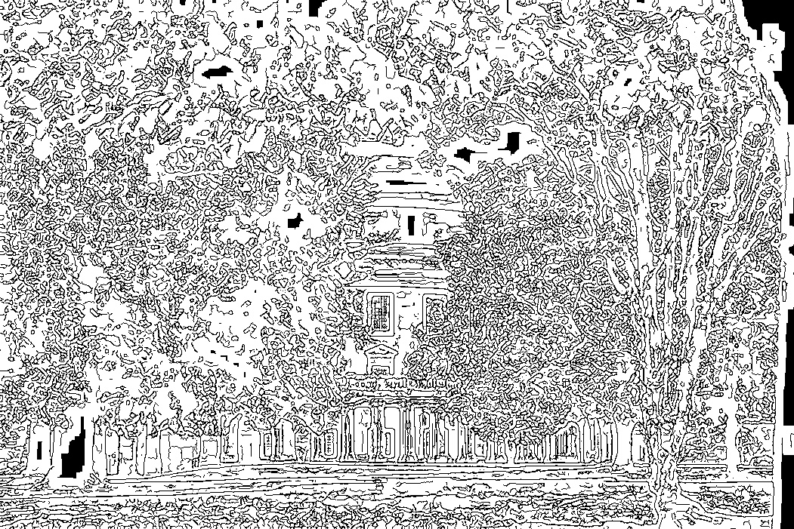
Read image
Blur
Generate points (edge detection)
Avoid

Slide 4
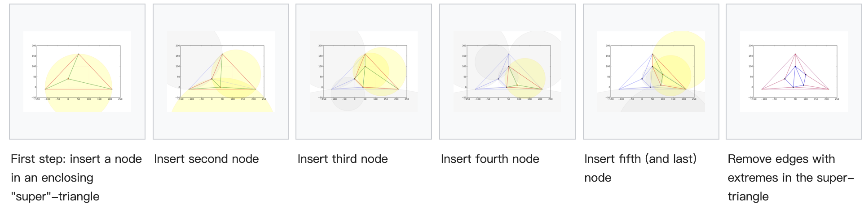
Bowyer-Watson algorithm
Delaunay triangulation
Voronoi diagram

Slide 5
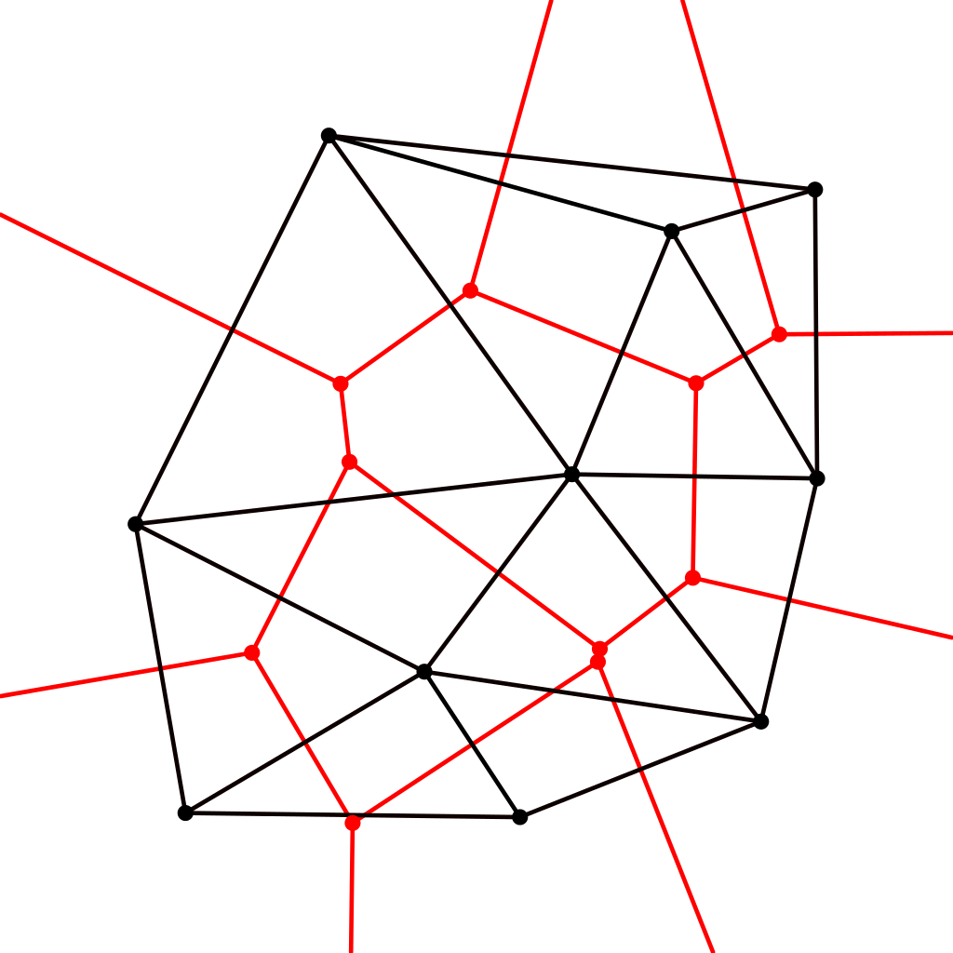
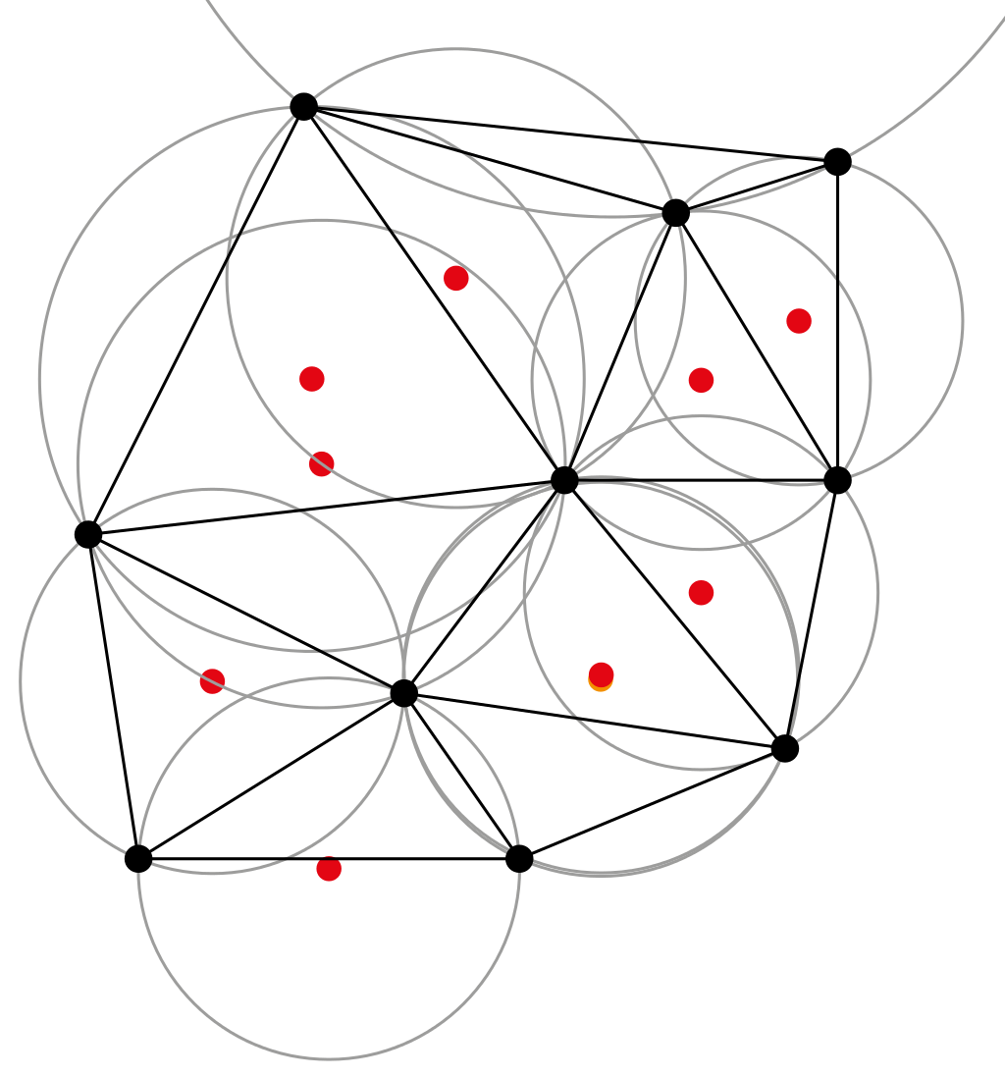
Bowyer-Watson algorithm
Delaunay triangulation
Voronoi diagram

Slide 6
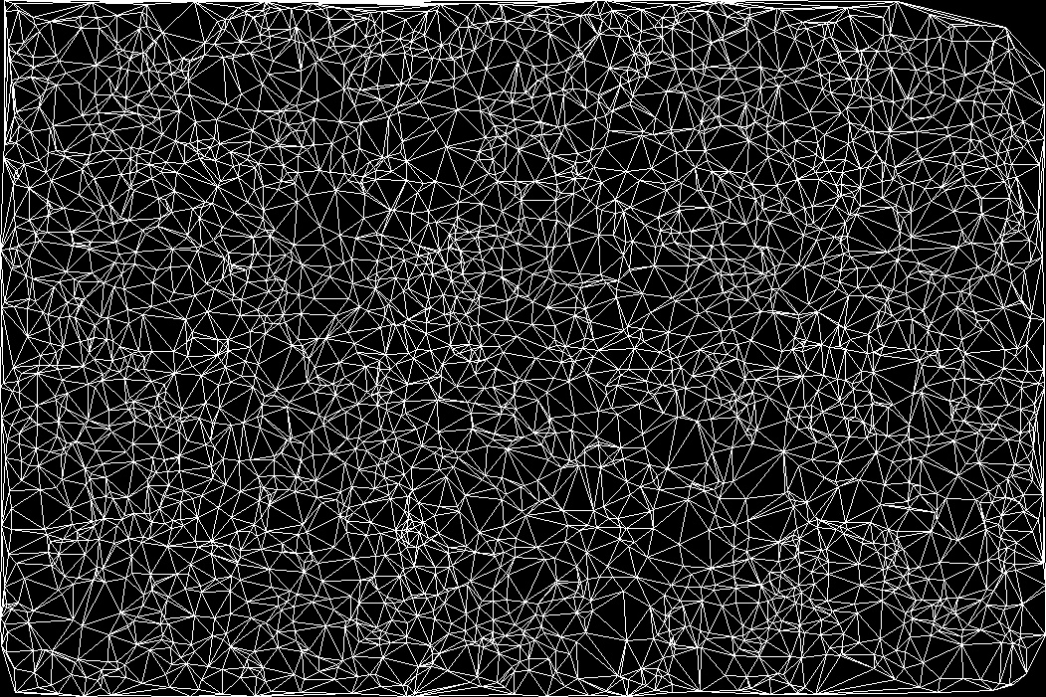
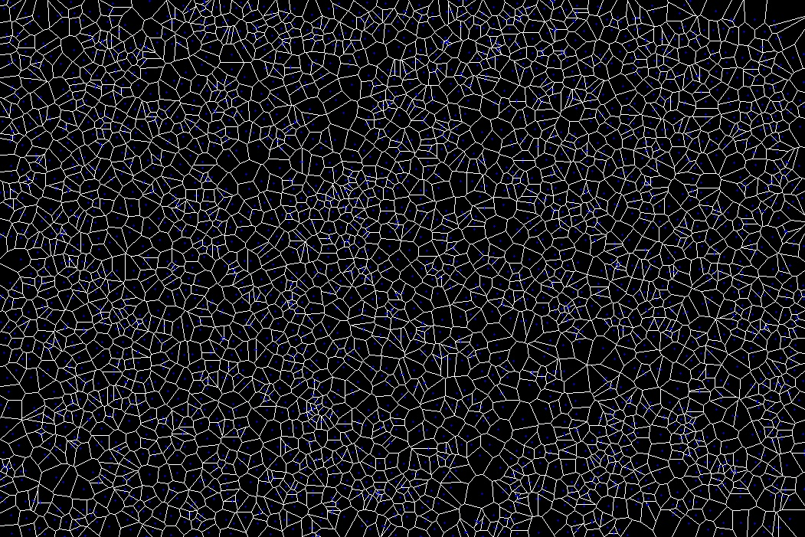
Bowyer-Watson algorithm
Delaunay triangulation
Voronoi diagram

Slide 7
painting
Invert
Isolate
mean & flood fill
blur edge

Slide 8
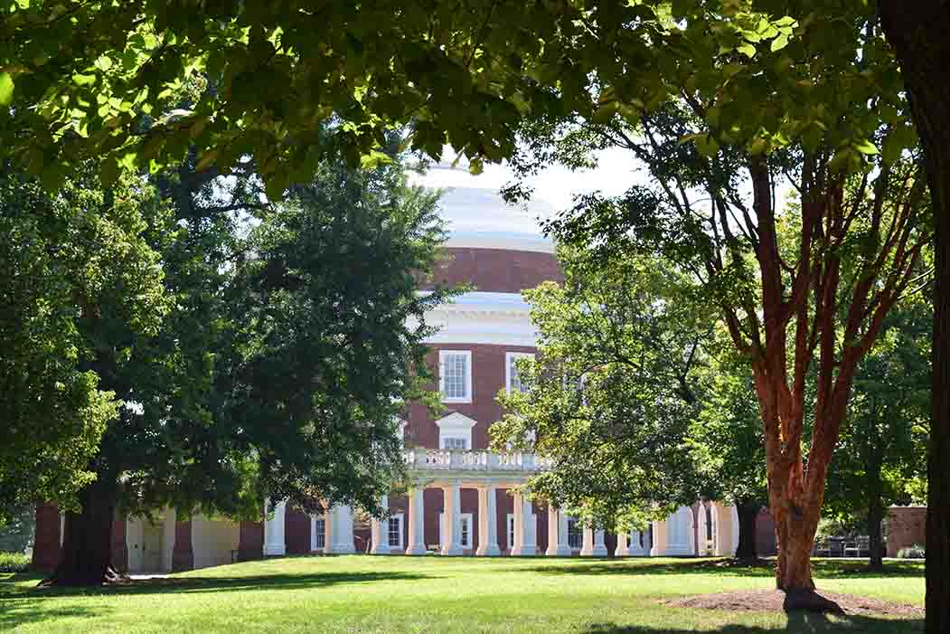
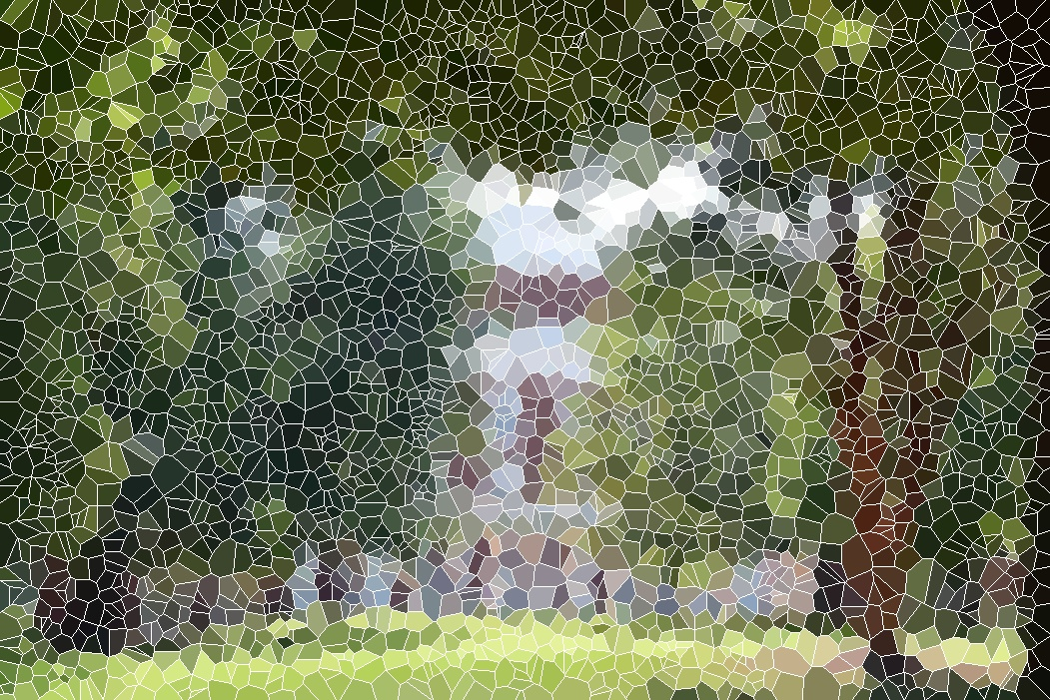
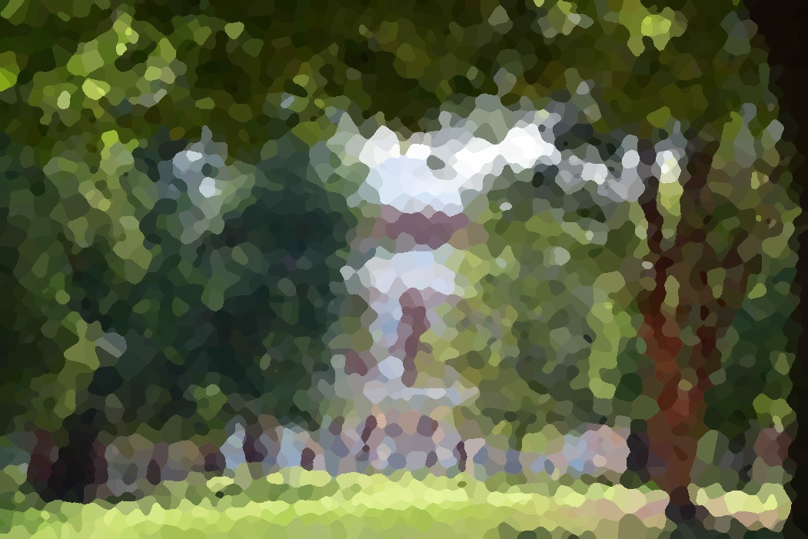


Slide 9
Thank you

